Slide 1
Analysis of Total Geographical Land Use and Prediction of Crops using Various ML Models
Review - 2
20BCE1043 (Vishal N)
20BCE1360 (Prathiba Narayan)
20BCE1317 (Jyothssena GS)

Slide 2
CLASSIFICATION MODELS
Support Vector Classifier
Decision Tree
Random Forest
Gradient Boosting
XGBoost
Linear Regression
Deep learning

Slide 3
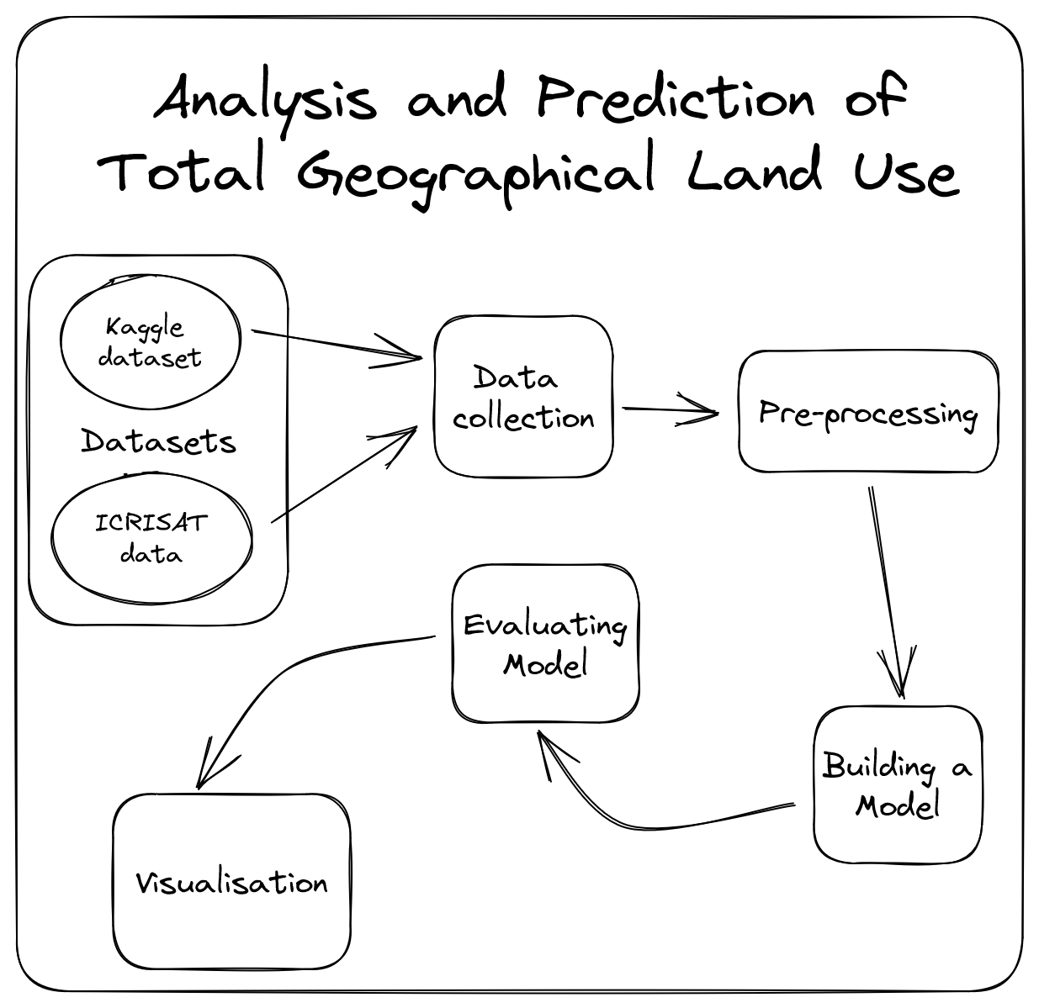
ARCHITECTURE DIAGRAM

Slide 4
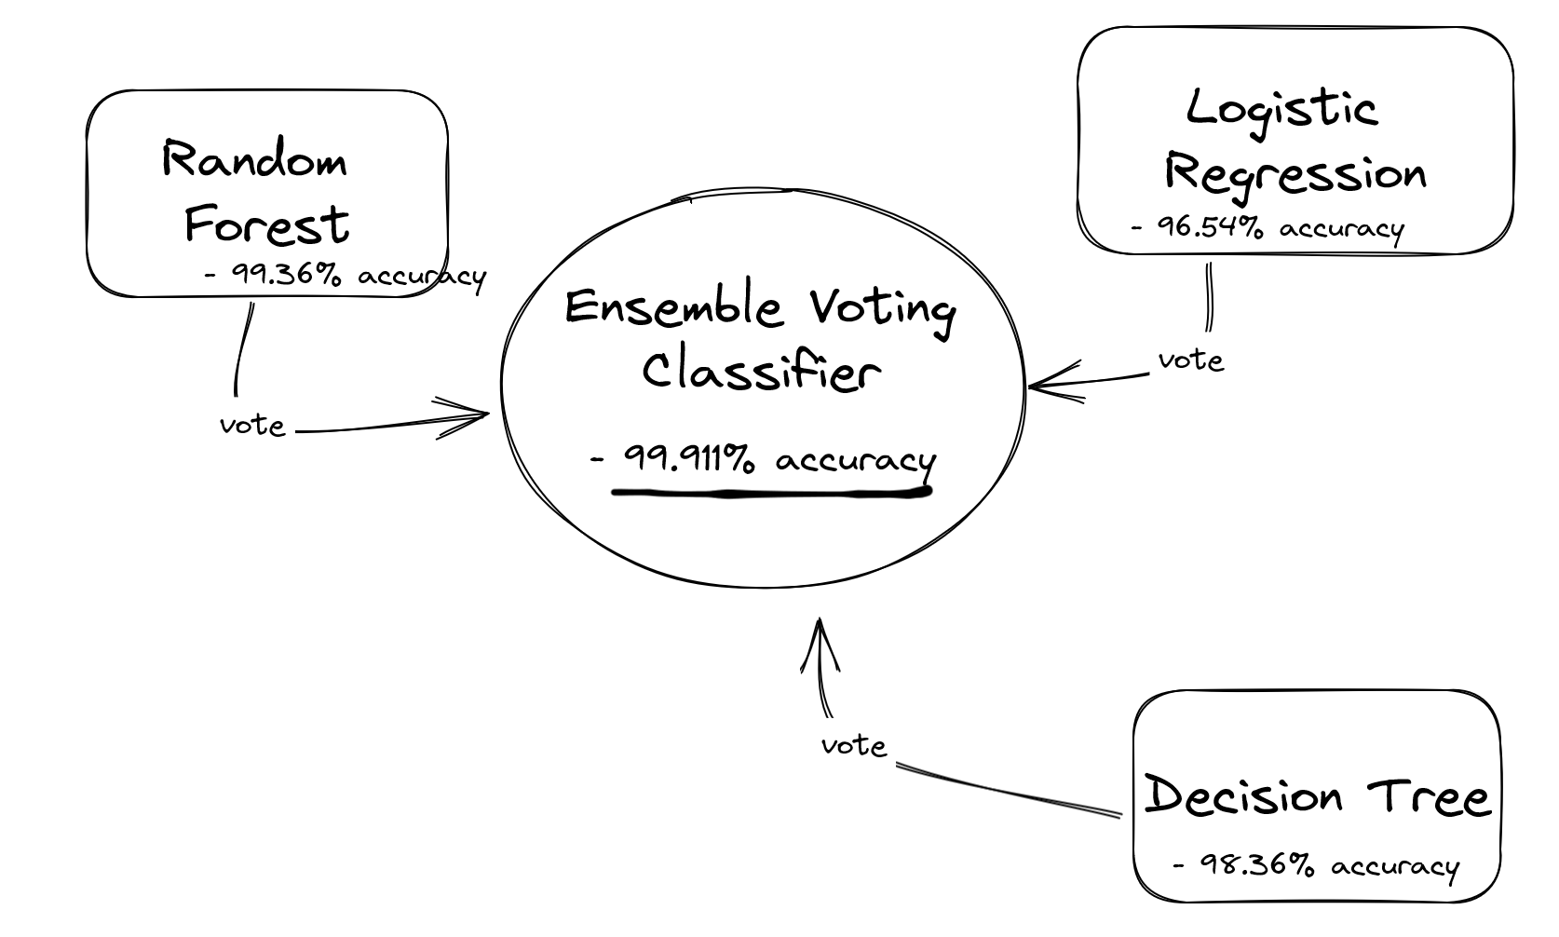
Ensemble Voting Classifier
Our model is capable of achieving an accuracy of > 99.91%.

Slide 5
MODEL RESULTS
MODEL | Accuracy
Decision Tree | 98.36%
Random Forest | 99.36%
Logistic Regression | 96.54%
Support Vector Classifier | 98.72%
XGBoost | 99.45%

Slide 6
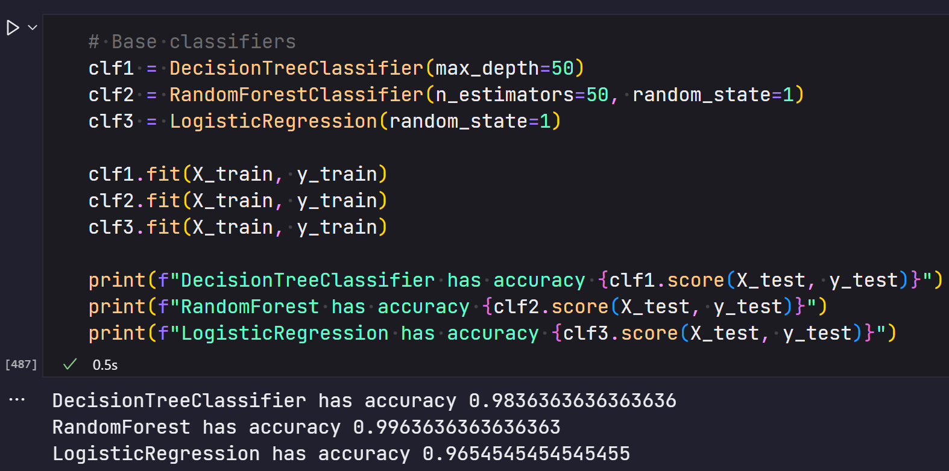
MODEL RESULTS

Slide 7
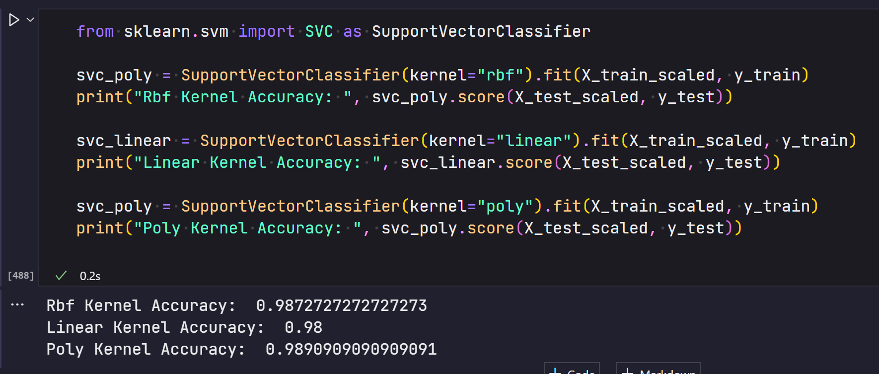
MODEL RESULTS

Slide 8
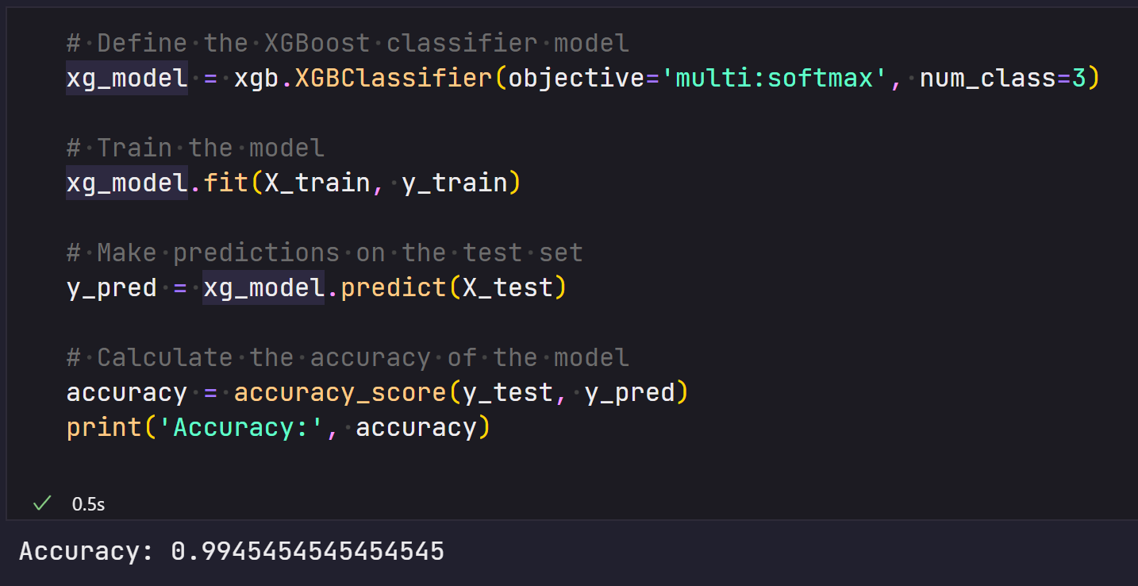
MODEL RESULTS

Slide 9
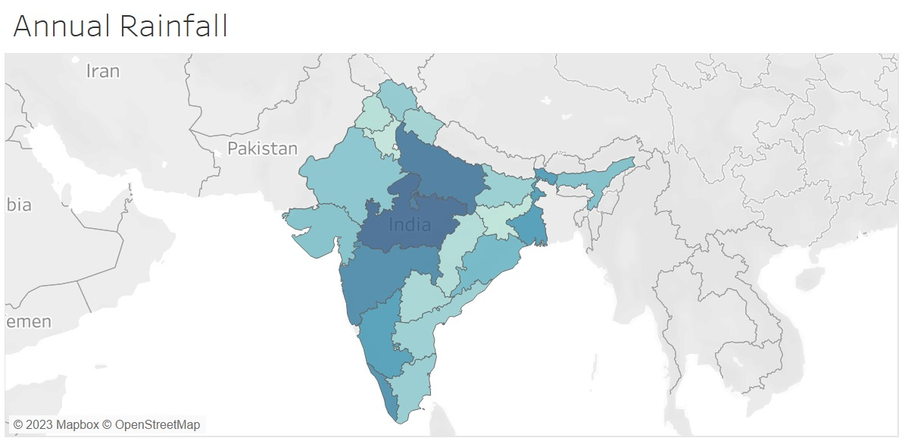
VISUALIZATION

Slide 10
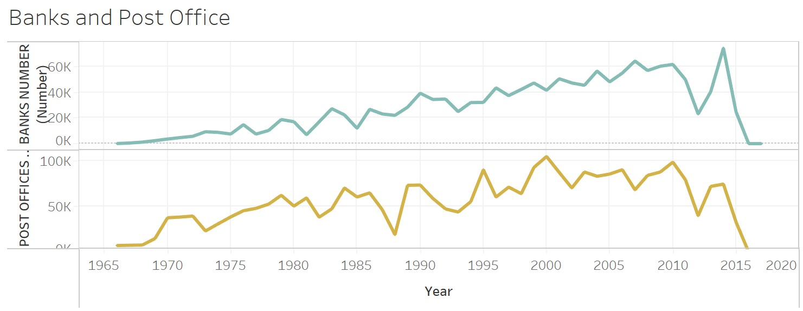
VISUALIZATION

Slide 11
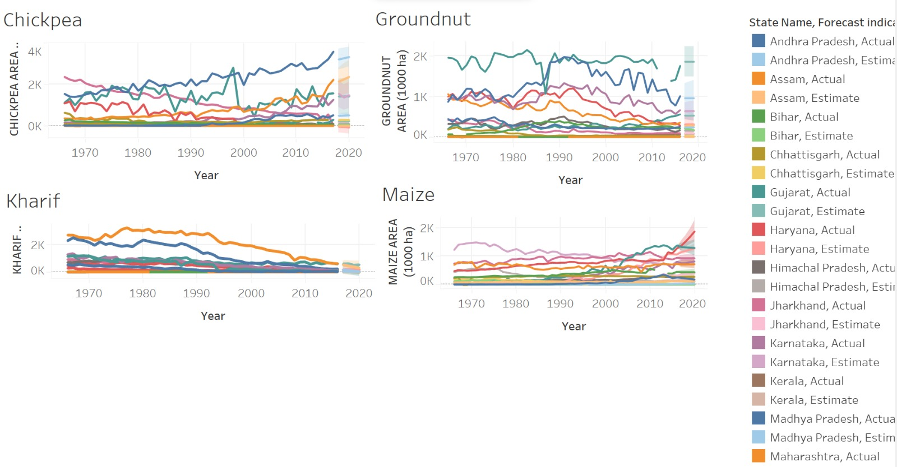
VISUALIZATION

Slide 12
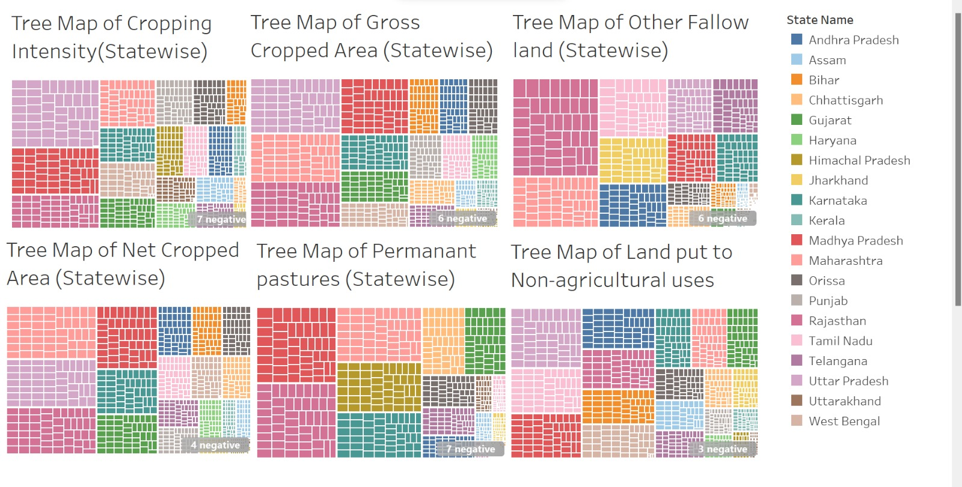
VISUALIZATION

Slide 13
Thank You

